Slide 1
Soft Computing
CS3EA03

Slide 2
UNIT- 1
Concept of Computing Systems, Introduction to Soft Computing, Soft Computing vs. Hard Computing, Components of Soft Computing, Neural Networks: Structure and function of Biological Neuron and Artificial Neuron, Definition and characteristics of ANN, Training techniques in different ANNs, Activation functions, Different ANNs architectures, Introduction to basic ANN architectures: McCulloch & Pitts model, Perceptron Model, Linear separability, ADALINE and MADALINE.

Slide 3

Concept of Computing Systems
Computer is an electronic device that takes raw data as input from the user and processes these data under the control of set of instructions (called program) and gives the result (output) and saves output for the future use.

Slide 4
Computer system
Data is a collection of unorganized facts & figures and does not provide any further information regarding patterns, context, etc. Hence data means "unstructured facts and figures".
Information is a structured data i.e. organized meaningful and processed data. To process the data and convert into information, a computer is used.

Slide 5

Data and information

Slide 6
Components of computer
Hardware
Software
Data
User

Slide 7
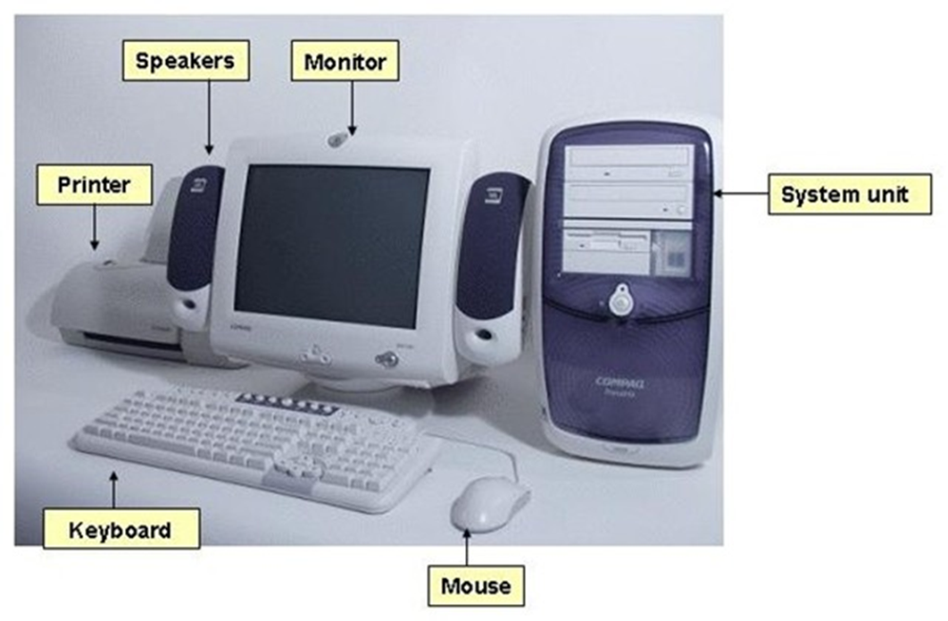
hardware
The term hardware refers to mechanical device that makes up computer. Computer hardware consists of interconnected electronic devices that we can use to control computer’s operation, input and output. Examples of hardware are CPU, keyboard, mouse, hard disk, etc.

Slide 8


software
A set of instructions that drives computer to do stipulated tasks is called a program. Software can be categorized into two types −
System software
Application software

Slide 9

data
Data is a collection of unorganized facts & figures and does not provide any further information regarding patterns, context, etc. Hence data means "unstructured facts and figures".

Slide 10

user
A person

Slide 11
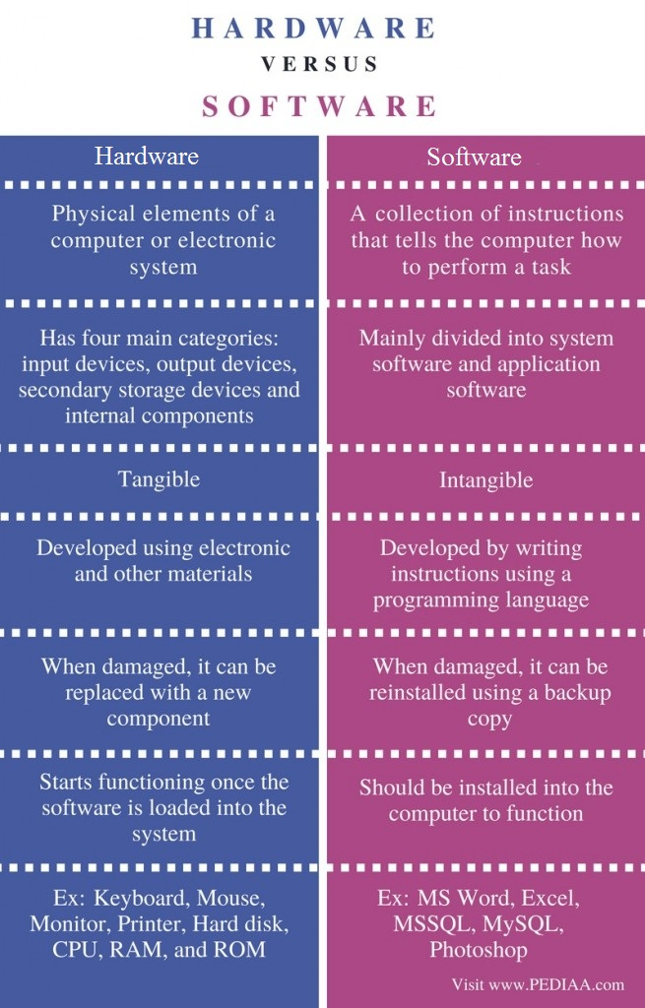
Hardware Vs. Software

Slide 12
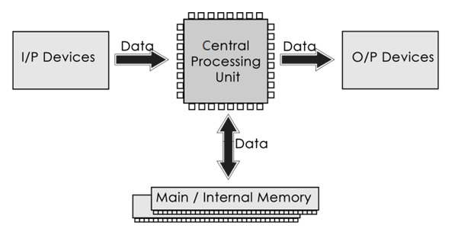
Functions of computer

Slide 13
Functions of computer
Receiving Input: Data is fed into computer through various input devices like keyboard, mouse, digital pens, etc. Input can also be fed through devices like CD-ROM, pen drive, scanner, etc.
Processing the information:- Operations on the input data are carried out based on the instructions provided in the programs.
Storing the information:- After processing, the information gets stored in the primary or secondary storage area.
Producing output:- The processed information and other details are communicated to the outside world through output devices like monitor, printer, etc.

Slide 14
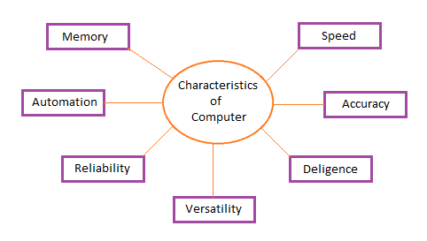
characteristics of the computer system

Slide 15
Basic Applications of Computer
Medical Field
Entertainment
Industry
Education
Government
Banking
Business
Training
Arts
Science and Engineering

Slide 16
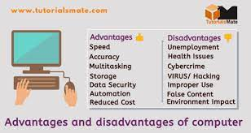
Advantages and Disadvantages

Slide 17
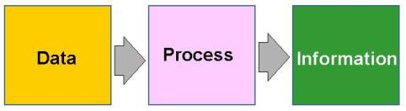
Data processing and its steps
Data processing is a process of converting raw facts or data into a meaningful information.

Slide 18
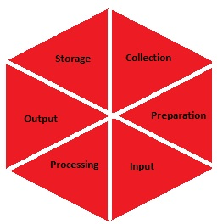
Stages of Data Processing

Slide 19
Stages of Data Processing
Collection:- Collection of data refers to gathering of data. The data gathered should be defined and accurate.
Preparation:- Preparation is a process of constructing a dataset of data from different sources for future use in processing step of cycle.
Input:- Input refers to supply of data for processing. It can be fed into computer through any of input devices like keyboard, scanner, mouse, etc.

Slide 20
Stages of Data Processing
Processing:- The process refers to concept of an actual execution of instructions. In this stage, raw facts or data is converted to meaningful information.
Output and Interpretation:- In this process, output will be displayed to user in form of text, audio, video, etc. Interpretation of output provides meaningful information to user.
Storage:- In this process, we can store data, instruction and information in permanent memory for future reference.

Slide 21


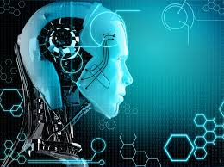
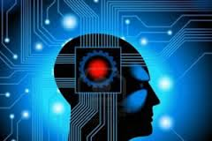
INTRODUCTION TO SOFT COMPUTING

Slide 22
Computing meaning
The process or act of calculation
C=a+b

Slide 23
Computing definition
The procedure of calculating; determining something by mathematical or logical methods
The process of accomplishing a particular task with the help of a computer or a computing device is known as computing. It should provide precise and accurate solutions, also it makes easy to find the mathematical solution of the problems.
"In a general way, we can define computing to mean any goal-oriented activity requiring, benefiting from, or creating computers.‖ This is a very broad definition that comprises the development of computer hardware, the use of computer applications, and the development of computer software.

Slide 24
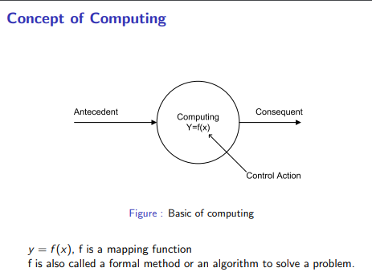

Slide 25
Concept of computing :
EXAMPLE:-
According to the concept of computing, the input is called an antecedent and the output is called the consequent. For example, Adding information in DataBase, Compute the sum of two numbers using a C program, etc.​

Slide 26
Types of computing
1. HARD COMPUTING
2. SOFT COMPUTING
3. HYBRID COMPUTING

Slide 27
Hard computing
It is a traditional approach used in computing which needs an accurately stated analytical model proposed by Dr. Lotfi Zadeh.
Example of Hard computing
Solving numerical problems (eg. Roots of polynomial)
Searching & sorting techniques
Solving computational geometry problems (eg. Shortest tour in graph, finding closest pair of points given a set of points etc.)

Slide 28
Characteristics of hard computing
The precise result is guaranteed​.
The control action is unambiguous​.
The control action is formally defined (i.e. with a mathematical model)

Slide 29
Pros and cons of hard comp.
Advantages
Accurate solutions can be obtained
Faster
Disadvantages
Not suitable for real world problems
Cannot handle imprecision and partial truth

Slide 30
Now, the question arises that if we have hard computing then why do we require the need for soft computing.

Slide 31
Take a example:
Consider a problem where a string
w1 is “abc” and string w2 is “abd”.
Problem-1 : Tell that whether w1 is the same as w2 or not?
Solution – The answer is simply No, it means there is an algorithm by which we can analyze it.

Slide 32
Take a example:
Problem-2 : Tell how much these two strings are similar?
Solution – The answer from conventional computing is either YES or NO. But these maybe 80% similar, this can be answered only by Soft Computing.

Slide 33
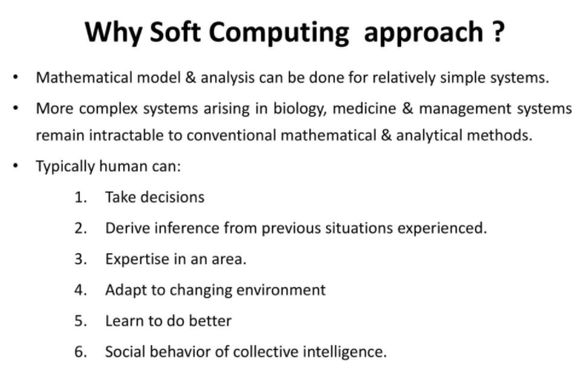

Slide 34
Need For Soft Computing :
Many analytical models are valid for ideal cases. Real-world problems exist in a non-ideal environment.
Soft computing provides insights into real-world problems and is just not limited to theory.

Slide 35
Need For Soft Computing :
Hard computing is best suited for solving mathematical problems which give some precise answers.
Some important fields like Biology, Medicine and humanities, etc are still intractable using Convention mathematical and Analytical models.
It is possible to map the human mind with the help of Soft computing but it is not possible with Convention mathematical and Analytical models.

Slide 36
Soft computing
The term soft computing was proposed by the inventor of fuzzy logic, Lotfi A. Zadeh
“Soft computing is a collection of methodology that aim to exploit the tolerance of imprecision & uncertainty to achieve tractability, robustness, & low solution on cost. Its principal constituents are fuzzy logic, neuro- Computing & probabilistic reasoning. The role model for soft computing is human mind”
The objective of soft computing is to provide precise approximation and quick solutions for complex real-life problems.

Slide 37
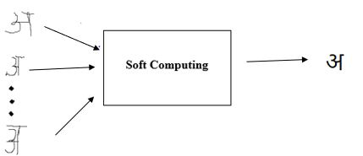
Soft computing

Slide 38
Example of soft Computing
Hand written character recognition (A.I.)
Money allocation problem (Evolutionary Computing)
Robot movement (Fuzzy logic)

Slide 39
Characteristics of soft computing
It may not yield a precise solution​.
Algorithms are adaptive.
In soft computing, you can consider an example where you can see the evolution changes for a specific species like the human nervous system and behavior of an Ant’s, etc.
Learning from experimental data.

Slide 40
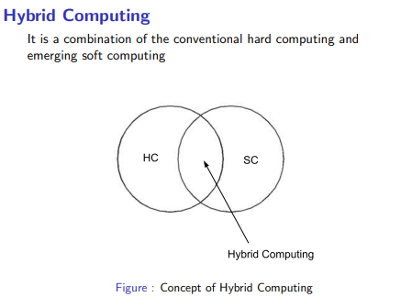

Slide 41
Recent development in Soft Computing :
In the field of Big Data, soft computing working for data analyzing models, data behavior models, data decision, etc.
In case of Recommender system, soft computing plays an important role for analyzing the problem on the based of algorithm and works for precise results.
In Behavior and decision science, soft computing used in this for analyzing the behavior, and model of soft computing works accordingly.
In the fields of Mechanical Engineering, soft computing is a role model for computing problems such that how a machine will works and how it will make the decision for a specific problem or input given.
In this field of Computer Engineering, you can say it is core part of soft computing and computing working on advanced level like Machine learning, Artificial intelligence, etc.

Slide 42
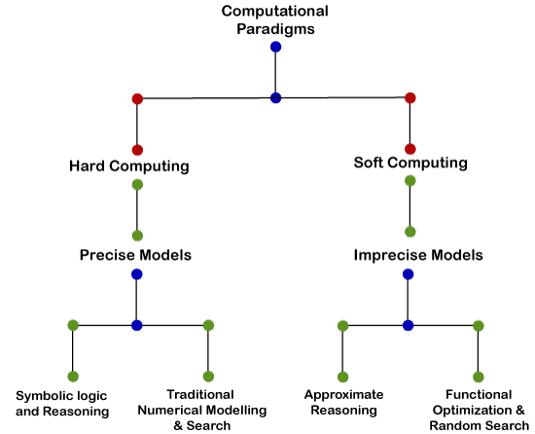
Soft computing vs. hard computing

Slide 43
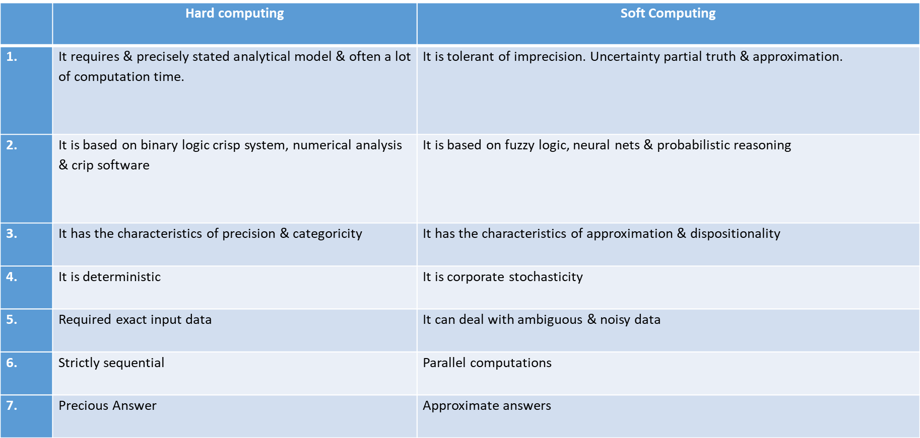

Slide 44
How to do Soft Computing
How students learn from his teacher?
Teacher asks questions & till the answers then.
Teacher puts questions & hints answer & ask whether the answers are correct or not
Students thus learn a topic & solve in his memory.
Based on the knowledge he solves new problems.
This is the way how human brain works.
Based on this concept Artificial neural N/W is used to solve problems.

Slide 45
How world selects the best?
It starts with a population (Random).
Reproduces another population (Next generation).
Rank the population & select the superior individuals.
Genetic algorithm is based on these natural phenomena.

Slide 46
How Doctor treats his patient?
Doctor asks the patient about suffering.
Doctor finds the symptoms of diseases.
Doctor prescribed test & medicines.
Symptoms are correlated with diseases with uncertainty.
Doctor prescribes tests/medicines fuzzily.

Slide 47
SOFT COMPUTING DEVELOPMENT HISTORY
Soft = Evolutionary + Neural + Fuzzy
Computing Computing Networks Logic
Zadeh Rechenberg Mcculloch Zadeh
1981 1960 1943 1965
Evolutionary = Genetic + Evolution + Evolutionary + Genetic
Computing Programming Strategies Programming Algorithms
Rechenberg Koza Rechenberg Fogel I Iolland
1960 1992 1965 1962 1970

Slide 48
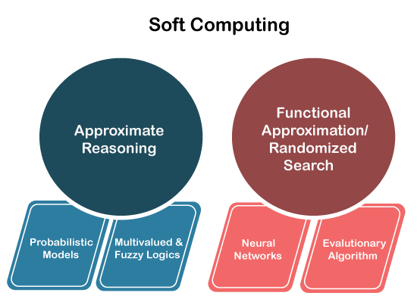
Elements of soft computing

Slide 49
Approximate reasoning
x = S₁A′s are B′s
y = S₂C′s are D′s
------------------------
z = S₃E′s are F′s

Slide 50
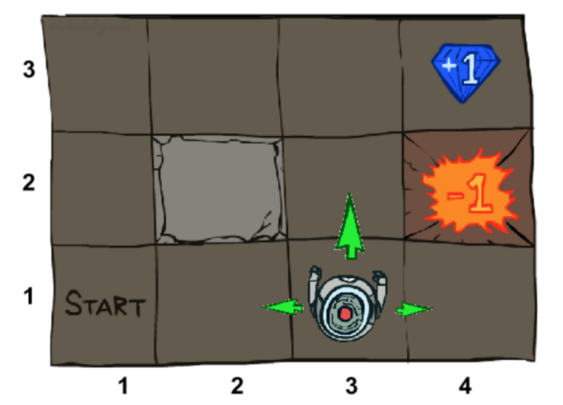
Functional Approximate

Slide 51
Elements of soft computing

Slide 52
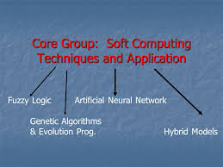
Soft computing techniques

Slide 53
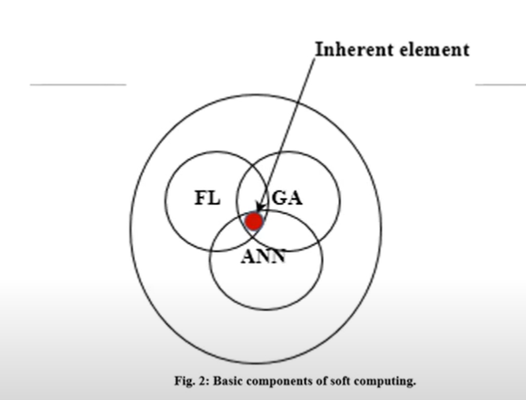

Slide 54
Neural Network
Neural networks were developed in the 1950s, which helped soft computing to solve real-world problems, which a computer cannot do itself.
An artificial neural network (ANN) emulates a network of neurons that makes a human brain (means a machine that can think like a human mind). Thereby the computer or a machine can learn things so that they can take decisions like the human brain.

Slide 55
Neural Network example

Slide 56
Fuzzy Logic
Fuzzy logic is nothing but mathematical logic which tries to solve problems with an open and imprecise spectrum of data. It makes it easy to obtain an array of precise conclusions.

Slide 57
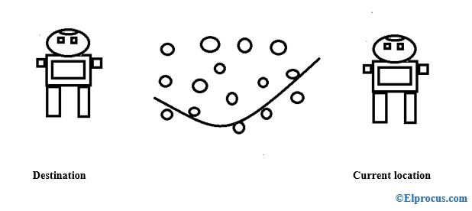
Fuzzy Logic Example

Slide 58
Genetic Algorithm
The genetic algorithm was introduced by Prof. John Holland in 1965. It is used to solve problems based on principles of natural selection, that come under evolutionary algorithm. They are usually used for optimization problems like maximization and minimization of objective functions, which are of two types of an ant colony and swarm particle. It follows biological processes like genetics and evolution.

Slide 59
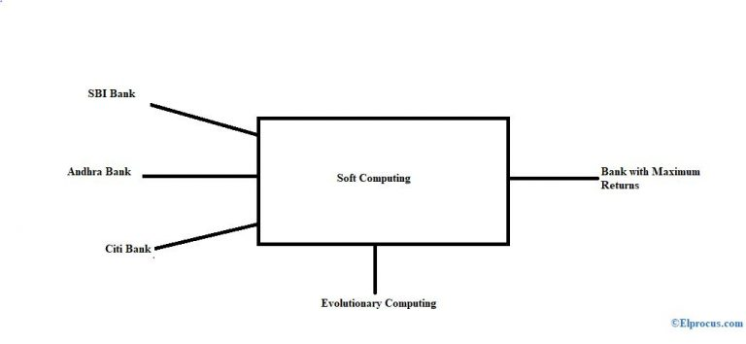
Genetic Algorithm example

Slide 60
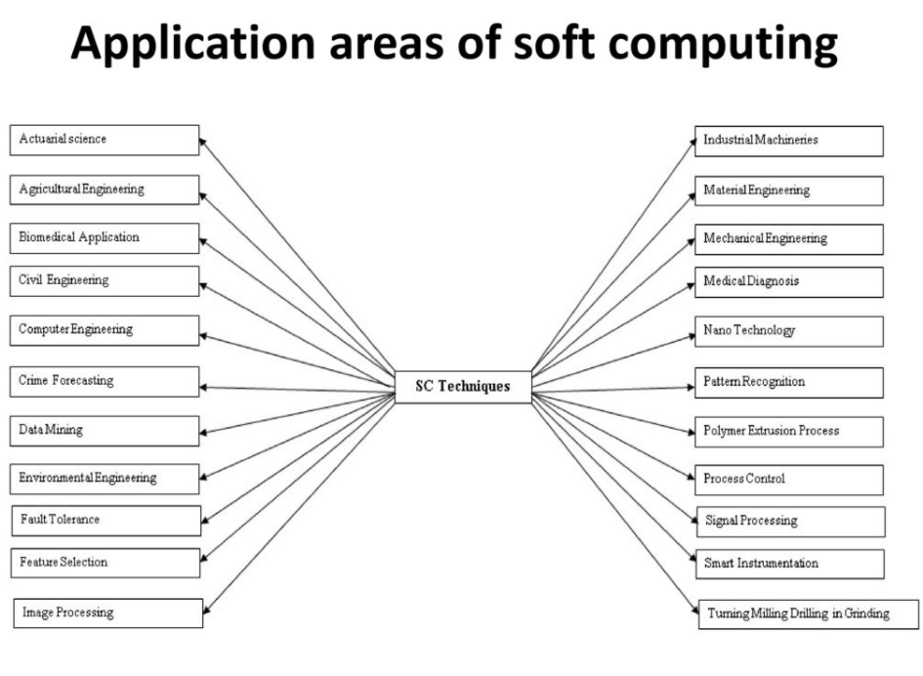

Slide 61
UNIT- 1
Concept of Computing Systems, Introduction to Soft Computing, Soft Computing vs. Hard Computing, Components of Soft Computing, Neural Networks: Structure and function of Biological Neuron and Artificial Neuron, Definition and characteristics of ANN, Training techniques in different ANNs, Activation functions,
Different ANNs architectures, Introduction to basic ANN architectures: McCulloch & Pitts model, Perceptron Model, Linear separability, ADALINE and MADALINE.

Slide 62
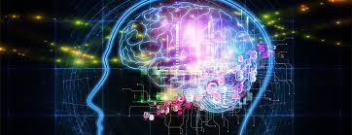
INTRODUCTION TO NEURAL NETWORK

Slide 63
Neural Network
Neural networks were developed in the 1950s, which helped soft computing to solve real-world problems, which a computer cannot do itself.
An artificial neural network (ANN) emulates a network of neurons that makes a human brain (means a machine that can think like a human mind). Thereby the computer or a machine can learn things so that they can take decisions like the human brain.

Slide 64
Neural Network example

Slide 65
Biological Inspirations
Humans perform complex tasks like vision, motor control, or language understanding very well.
One way to build intelligent machines is to try to imitate the (organizational principles of) human brain.

Slide 66
Human Brain
The brain is a highly complex, non-linear, and parallel computer, composed of some 10¹¹ neurons that are densely connected (~10⁴ connection per neuron). We have just begun to understand how the brain works...
A neuron is much slower (10⁻³sec) compared to a silicon logic gate (10⁻⁹sec), however the massive interconnection between neurons make up for the comparably slow rate.
– Complex perceptual decisions are arrived at quickly (within a few hundred milliseconds)
100-Steps rule: Since individual neurons operate in a few milliseconds, calculations do not involve more than about 100 serial steps and the information sent from one neuron to another is very small (a few bits)
Plasticity: Some of the neural structure of the brain is present at birth, while other parts are developed through learning, especially in early stages of life, to adapt to the environment (new inputs).

Slide 67
Biological Neuron
A variety of different neurons exist with different branching structures.
The connections of the network and the strengths of the individual synapses establish the function of the network.

Slide 68
Biological Neuron/Human Brain
Human brain contains about 10¹⁰ or 10¹¹ basic units called “Neurons”. Each neuron in turn ,is connected to about 10⁴ other neurons.
Size of brain is around 1.5 kg.
Size of Avg. neuron is around 1.5 * 10⁻⁹ grams.

Slide 69
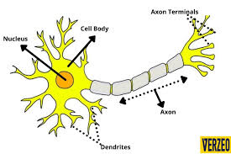
BIOLOGICAL NEURON STRUCTURE
SYNAPSE
SOMA

Slide 70
Working of a Biological Neuron
A typical neuron consists of the following four parts with the help of which we can explain its working
Dendrites − They are tree-like branches, responsible for receiving the information from other neurons it is connected to. In other sense, we can say that they are like the ears of neuron. The dendrites behave as input channel.
Soma − It is the cell body of the neuron and is responsible for processing of information, they have received from dendrites.
Axon − Axon is electrically active and serves as an output channel. It is just like a cable through which neurons send the information.
Synapses − The axon terminates in a specialized contact called synapse or synaptic junction that connects the axon with the dendrites links of another neuron. It contains a neuro-transmitter fluid which is responsible for accelerating or retarding the electric charges to soma.

Slide 71
Artificial Neural Networks
Computational models inspired by the human brain:
Massively parallel, distributed system, made up of simple processing units (neurons)
Synaptic connection strengths among neurons are used to store the acquired knowledge.
Knowledge is acquired by the network from its environment through a learning process

Slide 72
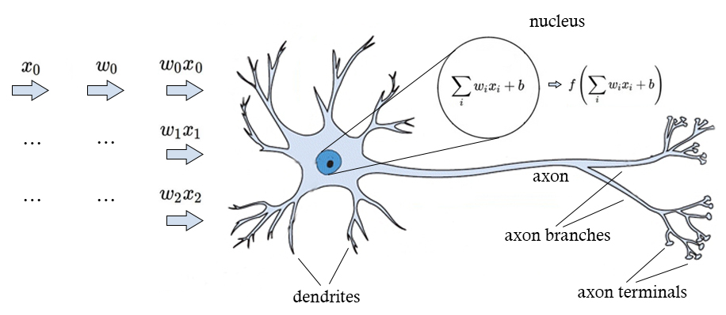
BIOLOGICAL NEURON STRUCTURE

Slide 73
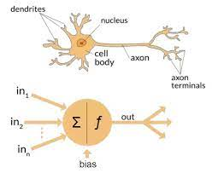
Biological and artificial neuron

Slide 74
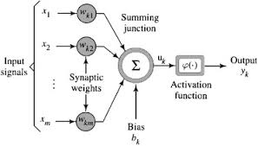
SIMPLE MODEL OF AN ARTIFICIAL NEURON
Biological Neural Network (BNN) | Artificial Neural Network (ANN)
Soma | Node
Dendrites | Input
Synapse | Weights or Interconnections
Axon | Output

Slide 75
Simple Model Of An Artificial Neuron
A neural net consists of a large number of simple processing elements called neurons, units, cells or nodes.
Each neuron is connected to other neurons by means of directed communication links, each with associated weight.
The weight represent information being used by the net to solve a problem.
Each neuron has an internal state, called its activation or activity level, which is a function of the inputs it has received. Typically, a neuron sends its activation as a signal to several other neurons.
It is important to note that a neuron can send only one signal at a time, although that signal is broadcast to several other neurons.

Slide 76
SIMPLE MODEL OF AN ARTIFICIAL NEURON
The total input I received by soma of artificial neuron
is
I = w1*x1 + w2*x2 + ….+wn*xn
=∑ wi*xi where i=1 to n
To generate the final output Y ,the sum is passed to filter Φ called activation function or transfer function or squash function which releases the output
Y=Φ(I) OR Y=F(X)

Slide 77
Artificial Neuron Model
x₀= +1
x₁
b_{i} :Bias
w
i1
x₂
x₃
Σ
f
a_{i}
Output
Neuron^{i}
Activation function
^{w}im
x_{m}
Input Synaptic
Weights

Slide 78
Artificial Neuron Model
n
a_{i} = f (n_{i}) = f (Σw_{ij}x_{j} + b_{i})
j = 1
An artificial neuron:
computes the weighted sum of its input (called its net input)
adds its bias
passes this value through an activation function
We say that the neuron “fires” (i.e. becomes active) if its output is above zero.

Slide 79
Bias
Bias can be incorporated as another weight clamped to a fixed input of +1.0
This extra free variable (bias) makes the neuron more powerful.
n
a_{i} = f (n_{i}) = f (Σw_{ij}x_{j}) = f(w_{i}.x_{j})
j = 0

Slide 80
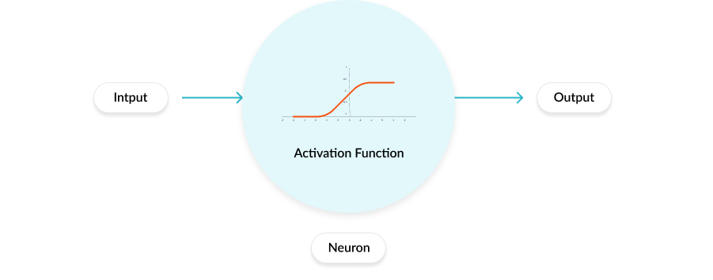
ACTIVATION FUNCTION
Activation functions are an extremely important feature of the artificial neural networks. They basically decide whether a neuron should be activated or not. Whether the information that the neuron is receiving is relevant for the given information or should it be ignored.

Slide 81
TYPES OF ACTIVATION FUNCTIONS
Identity functions
This function is denoted by f(x) = x for all x. The output here remains the same as input.
Binary step function
This function makes use of a threshold. A binary step function with a threshold T is given by
f(x) = 1 if x >= T
f(x) = 0 if x < T

Slide 82
TYPES OF ACTIVATION FUNCTIONS
Bipolar step function
This function makes use of a threshold. A bipolar step function with a threshold T is given by
f(x) = 1 if x >= T
f(x) = -1 if x < T

Slide 83
TYPES OF ACTIVATION FUNCTIONS
Sigmoid functions
Sometimes S shaped functions called sigmoid functions are used as activation functions which are found useful.
Binary sigmoid
The logistic function, which is a sigmoid function between 0 and 1 are used in neural network as activation function where the output values are either binary or varies from 0 to 1. It is also called as binary sigmoid or logistic sigmoid.
It is defined as f(x)=1/1+e^{-x}

Slide 84
TYPES OF ACTIVATION FUNCTIONS
Bipolar Sigmoid
A logistic sigmoid function can be scaled to have any range of values which may be appropriate for a problem.The most common range is from -1 to 1.
It is defined as 2/1+e^{-x} -1
Ramp function
It is defined as
f(x) = 1 if x > 1
f(x) = x if 0<= x <=1
f(x) = 0 if x < 0

Slide 85
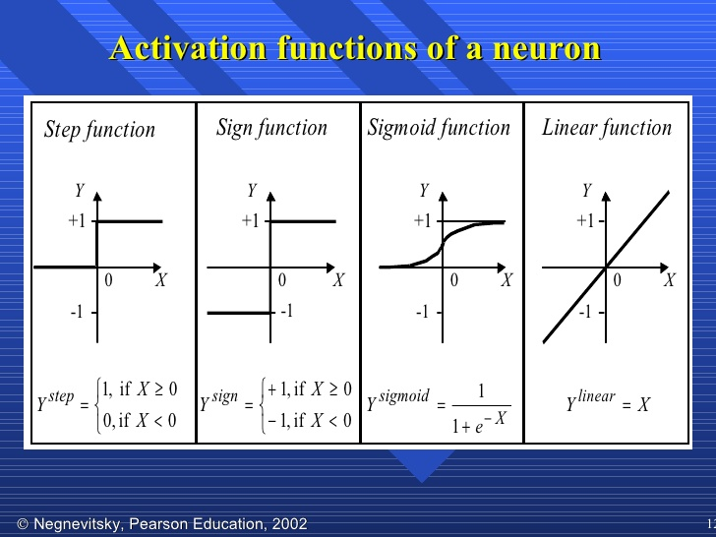

Slide 86
Properties of ANNs
Learning from examples
labeled or unlabeled
Adaptivity
changing the connection strengths to learn things
Non-linearity
the non-linear activation functions are essential
Fault tolerance
if one of the neurons or connections is damaged, the whole network still works quite well
Thus, they might be better alternatives than classical solutions for problems characterised by:
high dimensionality, noisy, imprecise or imperfect data; and
a lack of a clearly stated mathematical solution or algorithm

Slide 87
Comparison between ANN and BNN
Criteria | BNN | ANN
Processing | Massively parallel, slow but superior than ANN | Massively parallel, fast but inferior than BNN
Size | 10¹¹ neurons and 10¹⁵interconnections | 10² to 10⁴ nodes (mainly depends on the type of application and network designer)
Learning | They can tolerate ambiguity | Very precise, structured and formatted data is required to tolerate ambiguity
Fault tolerance | Performance degrades with even partial damage | It is capable of robust performance, hence has the potential to be fault tolerant
Storage capacity | Stores the information in the synapse | Stores the information in continuous memory locations
Comparison between ANN and BNN

Slide 88
Types of learning
SUPERVISED LEARNING
2. UNSUPERVISED LEARNING
3. REINFORCEMENT LEARNING

Slide 89
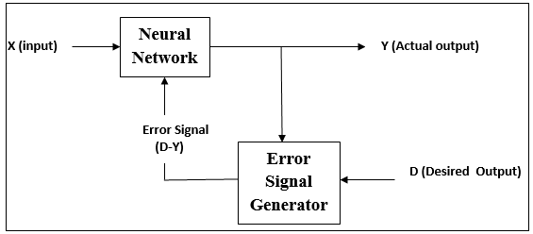
TYPES OF LEARNING
Supervised Learning---The learning algorithm would fall under this category if the desired output for the network is also provided with the input while training the network. By providing the neural network with both an input and output pair it is possible to calculate an error based on it's target output and actual output. It can then use that error to make corrections to the network by updating it's weights.

Slide 90
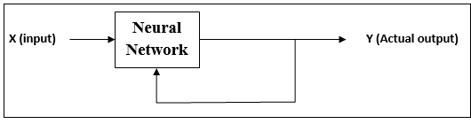
TYPES OF LEARNING
Unsupervised Learning---In this paradigm the neural network is only given a set of inputs and it's the neural network's responsibility to find some kind of pattern within the inputs provided without any external aid. This type of learning paradigm is often used in data mining and is also used by many recommendation algorithms due to their ability to predict a user's preferences based on the preferences of other similar users it has grouped together.

Slide 91
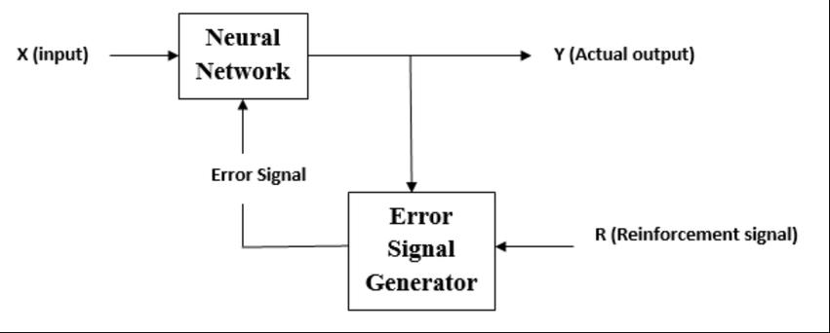
TYPES OF LEARNING
Reinforcement Learning---Reinforcement learning is similar to supervised learning in that some feedback is given, however instead of providing a target output a reward is given based on how well the system performed. The aim of reinforcement learning is to maximize the reward the system receives through trial-and-error. This paradigm relates strongly with how learning works in nature, for example an animal might remember the actions it's previously taken which helped it to find food (the reward).

Slide 92
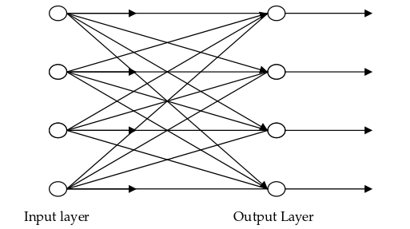
NEURAL NETWORK ARCHITECTURE
Single-layer feed forward network-Neural network in which the input layer of source nodes projects into an output layer of neurons but not vice-versa is known as single feed-forward or acyclic network. In single layer network, ‘single layer’ refers to the output layer of computation nodes

Slide 93
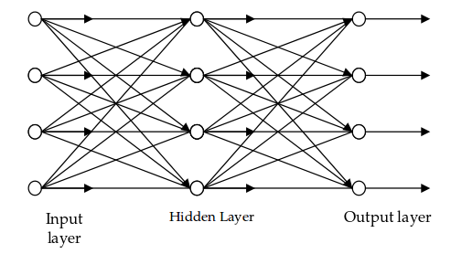
NEURAL NETWORK ARCHITECTURE
Multilayer feed forward network-This type of network consists of one or more hidden layers, whose computation nodes are called hidden neurons or hidden units. The function of hidden neurons is to interact between the external input and network output in some useful manner and to extract higher order statistics. The source nodes in input layer of network supply the input signal to neurons in the second layer (1st hidden layer). The output signals of 2nd layer are used as inputs to the third layer and so on.

Slide 94
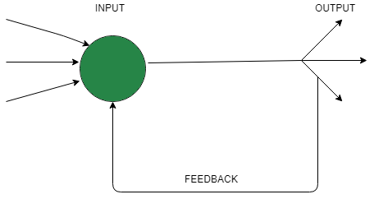
NEURAL NETWORK ARCHITECTURE
Single node with its own feedback-When outputs can be directed back as inputs to the same layer or preceding layer nodes, then it results in feedback networks. Recurrent networks are feedback networks with closed loop. Figure shows a single recurrent network having single neuron with feedback to itself.

Slide 95
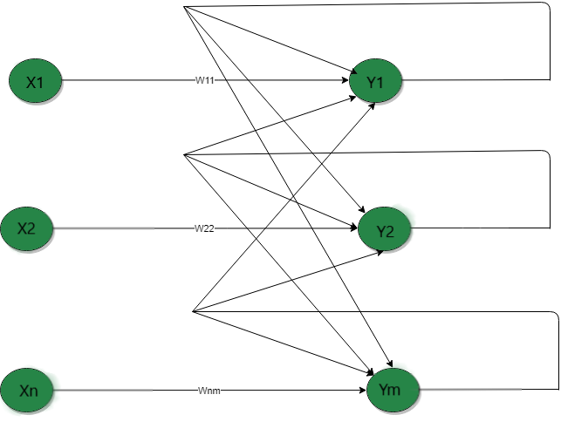
NEURAL NETWORK ARCHITECTURE
Single-layer recurrent network-feed forward neural network having one or more hidden layers with at least one feedback loop is known as recurrent network .Below network is single layer network with feedback connection in which processing element’s output can be directed back to itself or to other processing element or both.

Slide 96
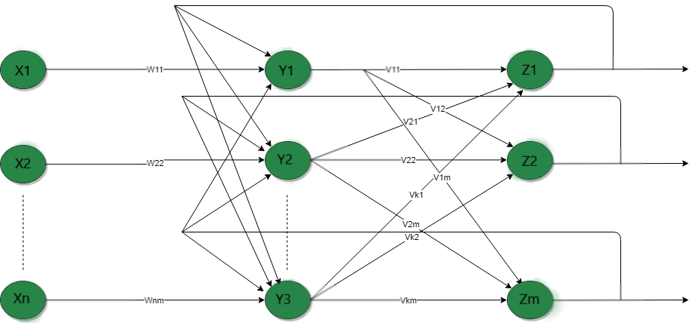
NEURAL NETWORK ARCHITECTURE
Multilayer recurrent network-In this type of network, processing element output can be directed to the processing element in the same layer and in the preceding layer forming a multilayer recurrent network. They perform the same task for every element of a sequence, with the output being depended on the previous computations. Inputs are not needed at each time step.

Slide 97
UNIT- 1
Concept of Computing Systems, Introduction to Soft Computing, Soft Computing vs. Hard Computing, Components of Soft Computing, Neural Networks: Structure and function of Biological Neuron and Artificial Neuron, Definition and characteristics of ANN, Training techniques in different ANNs, Activation functions,
Different ANNs architectures, Introduction to basic ANN architectures: McCulloch & Pitts model, Perceptron Model, Linear separability, ADALINE and MADALINE.

Slide 98
The McCulloch-Pitts/MP Model of Neuron
The early model of an artificial neuron is introduced by Warren McCulloch and Walter Pitts in 1943. The McCulloch-Pitts model was an extremely simple artificial neuron.
It allows binary 0/1 states, bcz it is binary activated.
The neurons are connected by direct weight graph.
The connection path can be excitatory/inhibitory.

Slide 99
The McCulloch-Pitts Model of Neuron
The "neurons" operated under the following assumptions:-
They are binary devices (Vi = [0,1])
Each neuron has a fixed threshold, theta values.
The neuron receives inputs from excitatory synapses, all having identical weights.
Inhibitory inputs have an absolute veto power over any excitatory inputs.
At each time step the neurons are simultaneously (synchronously) updated by summing the weighted excitatory inputs and setting the output (Vi) to 1 if the sum is greater than or equal to the threshold and if the neuron receives no inhibitory input.

Slide 100
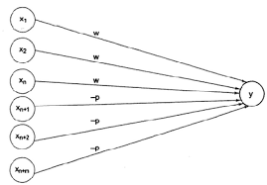
Architecture of McCulloch-Pitts Model
From the above fig, the connected path are of two types: excitatory or inhibitory. Excitatory have positive weight and which denoted by “w” and inhibitory have negative weight and which is denoted by “p”. The neuron fires if the net input to the neuron is greater than threshold. The threshold is set so that the inhibition is absolute, because, nonzero inhibitory input will prevent the neuron from firing.

Slide 101
Architecture of McCulloch-Pitts Model
The McCulloch Pitts neuron Y has the activation function:
Y =F (yin) = 1 if y-in ≥ Ѳ
0 if y-in < Ѳ
Where, Ѳ=threshold
Y=net output
By using MCCULLOCH Pitts model we are going to solve the following logic gates. i. OR Gate ii. NOT Gate iii. AND Gate iv. NAND Gate v. XOR Gate vi. NOR Gate

Slide 102
Learning: Rules
McCulloch-Pitts Neurons: Obtain the weights by performing analysis of the problem

Slide 103
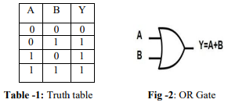
Realization of Logic Gates
OR GATE
The OR gate is a digital logic gate that implements logical disjunction-it behaves according to the truth table. A high output i.e. 1 results if one or both the OR GATE inputs to the gate are high (1).If both inputs are low the result is low (0)[1]. A plus (+) is used to show the or operation. [2] Its block diagram and truth table is shown by:

Slide 104
OR GATE
Net Input = X1*W1+X2*W2
Equation-I
X1*W1+X2*W2< θ
0 < θ
Equation-II
X1*W1+X2*W2>= θ
W2 >= θ
Equation-III
X1*W1+X2*W2>= θ
W1 >= θ
Equation-IV
X1*W1+X2*W2>= θ
W1+W2 >= θ

Slide 105
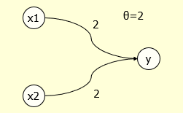
OR GATE
Net input yin = x1w1+x2w2
yin = 0*2+0*2
yin = 0+0
0
1. F(yin)< theta and 2. F(yin)>= theta
0<2 output is 0

Slide 106
OR GATE
Net input yin = x1w1+x2w2
yin = 0*2+1*2
yin = 0+2
2
1. F(yin)< theta and 2. F(yin)>= theta
2=2 output is 1

Slide 107
OR GATE
Net input yin = x1w1+x2w2
yin = 1*2+0*2
yin = 2+0
2
1. F(yin)<theta and 2. F(yin)>= theta
2=2 output is 1

Slide 108
OR GATE
Net input yin = x1w1+x2w2
yin = 1*2+1*2
yin = 2+2
4
1. F(yin)< theta and 2. F(yin)>= theta
4>2 output is 1

Slide 109
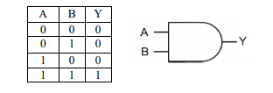
Realization of Logic Gates
AND GATE
It is a logic gate that implements conjunction. Whenever both the inputs are high then only output will be high (1) otherwise low (0).

Slide 110
AND Gate
Net Input = X1*W1+X2*W2
Equation-I
X1*W1+X2*W2< θ
0 < θ
Equation-II
X1*W1+X2*W2>= θ
W2 < θ
Equation-III
X1*W1+X2*W2>= θ
W1 < θ
Equation-IV
X1*W1+X2*W2>= θ
W1+W2 >= θ

Slide 111
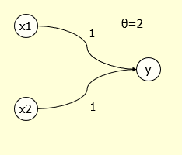
AND Gate
Net input yin = x1w1+x2w2
yin = 0*1+0*1
yin = 0+0
0
1. F(yin)< theta and 2. F(yin)>= theta
0<2 output is 0

Slide 112
AND Gate
Net input yin = x1w1+x2w2
yin = 0*1+1*1
yin = 0+1
1
1. F(yin)< theta and 2. F(yin)>= theta
1<2 output is 0

Slide 113
AND Gate
Net input yin = x1w1+x2w2
yin = 1*1+0*1
yin = 1+0
1
1. F(yin)< theta and 2. F(yin)>= theta
1<2 output is 0

Slide 114
AND Gate
Net input yin = x1w1+x2w2
yin = 1*1+1*1
yin = 1+1
2
1. F(yin)< theta and 2. F(yin)>= theta
2=2 output is 1

